Slide 1
Introduction to javascript
from zero to hero

Slide 2
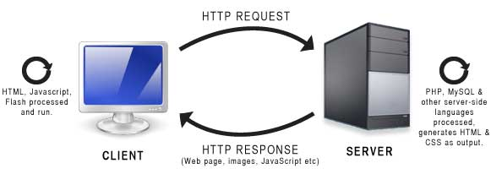
Web based scripting language
Client side script
Server side script
VB script
Javascript
Python
.net
Nodejs
PHP
html

Slide 3
Why we learn javascript?
Javascript is a event based programming language
Click
Hover
Double click
Drag drop
Right click
Load
Key press
Key up
Scroll

Slide 4
Banefits of learning javascript:
Web development ( jQuerry, Angular Js, react.js, vuejs, nodejs )
Destop app development ( electron Js )
Mobile app development (Angular js, react.js, vuejs, react native, nose js )

Slide 5
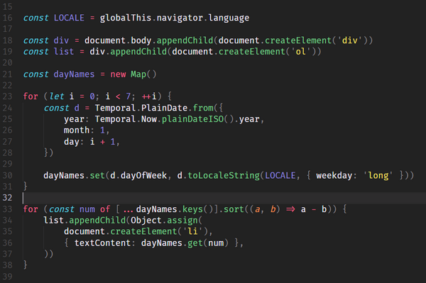
Uses of JavaScript in wed development
Dropdown menu
Animated sliders
Maps
Charts
Form validation
Full e-commerce websites

Slide 6

Editor for javascript
Notepad
Notepad ++
Vs code
Sublime
atom

Slide 7
Web browsers for javascript
Google chrome
Mozilla firefox
Internert explorer
safari

Slide 8

THANK YOU FOR WATCHING
if you have any question feel free to ask me in comment section i will answer all question in my next video and don’t forgot to subscribe my channel and press the bell icon
THEJAMSVLOGS

